Slide 1
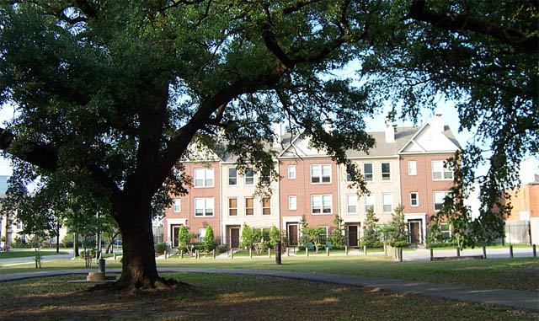
Baldwin Square Homeowners Association
2020 Annual Meeting
November 10, 2020

Slide 2
BSHA Overview
Incorporated in 1998
Originally established by Perry Homes (builder of our homes)
Became homeowner controlled in 2003
165 Townhomes
13 townhome communities (grouped townhomes)
10 gated, 3 without gates
Common Assets Maintained
Landscaping, iron & wood fences, drive gates, irrigation, some grouped residential water lines
Common driveways, storm drains, & ROW
Registered, with statutes & guidelines

Slide 3
BALDWIN SQUARE HOMEOWNERS ASSOC
DENNIIS TOWNHOMES
BALDWIN SQUARE IV
McGOWEN
2900 CAROLINE
1300 TUAM
AUSTIN
CRAWFORD COURT
CAROLINE STREET
BALDWIN SQUARE I
2700 CRAWFORD
DENNIS
2800 LA BRANCH
1500 DREW
1300 ANITA
1400 TUAM
2900 AUSTIN
ANITA STREET I
BALDWIN SQUARE III
DREW
2800 CRAWFORD
BALDWIN SQUARE II
2900 LA BRANCH
1500 TUAM
TUAM TOWNHOMES
JACKSON
Pedestrian
1600 TUAM
Drive Entrance
1500 ANITA
2900 CRAWFORD
Drive Exit
1400 ROSALIE
3000 LA BRANCH
BALDWIN SQUARE V
ANITA STREET II
2900 JACKSON
1500 ROSALIE
BALDWIN COURT
ANITA STREET III
ELGIN

Slide 4
2020 Annual Meeting Agenda
Order, Quorum, Introductions
2019 Meeting Minutes Review & Approval
Board Member Election
2020 Financial Report
2020 Accomplishments
2021 Goals
2021 Budget, Assessments, and Goals
Q & A

Slide 5
BSHA 2020 Board
Lisa Romero - President
Term Expires November 2020
Kelly Reynolds – Vice President
Term Expires November 2021
Viet Nguyen – Secretary & Treasurer
Term Expires November 2021

Slide 6
BSHA Managing Agent
Midtown Management Corporation
Sonya Bradley
Community Manager
Primary contact for BS HOA
Connie Navarre
Customer Support Assistant
Secondary contact for BS HOA
Contact Information
713-489-4901
Website: www.baldwinsquare.org

Slide 7
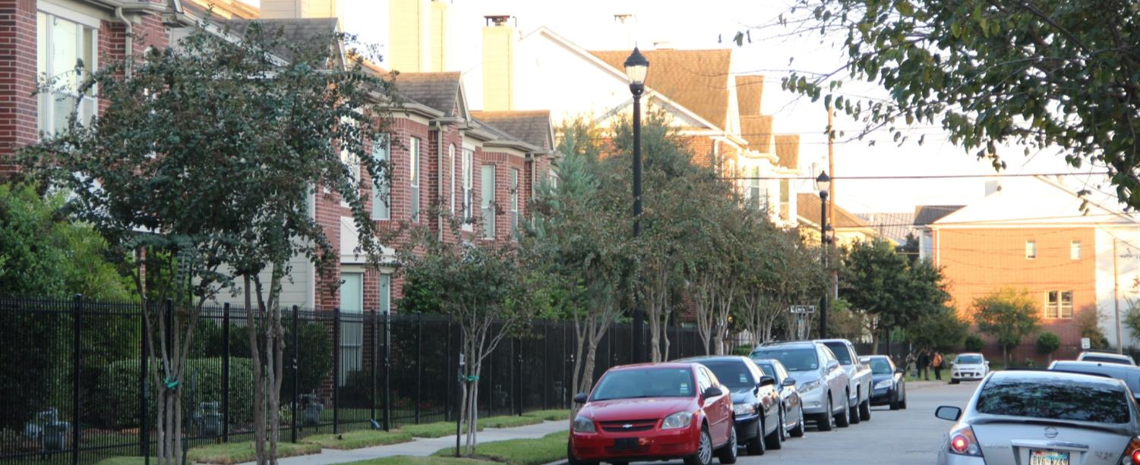
2019 Annual Meeting Minutes
Was provided in your mail-out package with your proxy form
Any corrections or additions?
Motion for Approval

Slide 8
2021 Board Election
1 Open Position
Lisa Romero’s position
Commitment, proficiencies needed
2 Year Term
Monthly Board Meetings
+/- 90 min, 3rd Wed 4pm @ Crime Stoppers HQ
Ad hoc meetings if needed
Use of e-mail / MS Office
Critical traits wanted
Objective, making decisions fair to all
Putting best interests of entire community first
Budget / spending accountability & fiscal responsibility
Diligence & responsive
Putting aside differences and working as a team
Nominations from the floor

Slide 9
2020 - Accomplishments

Slide 10
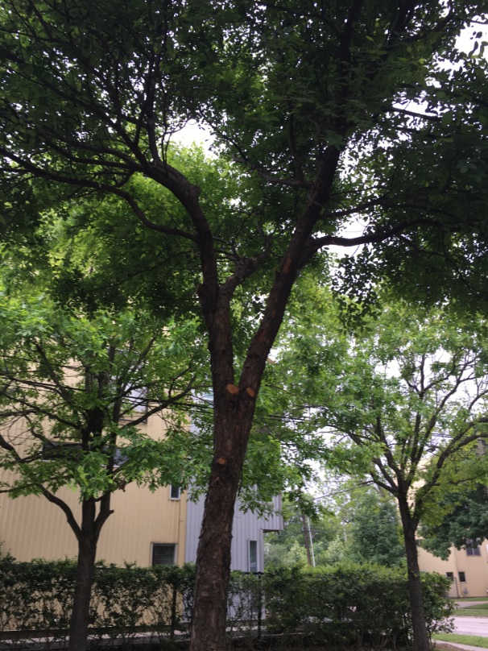
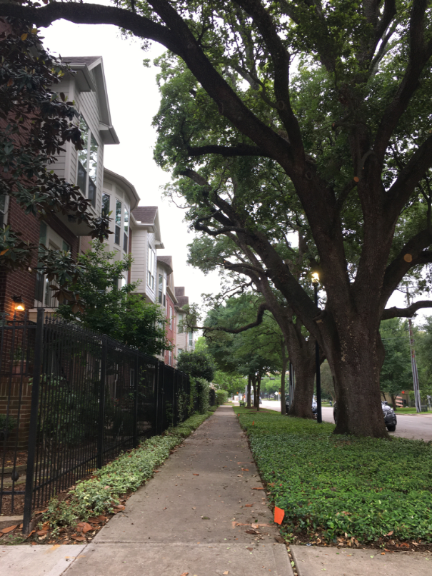
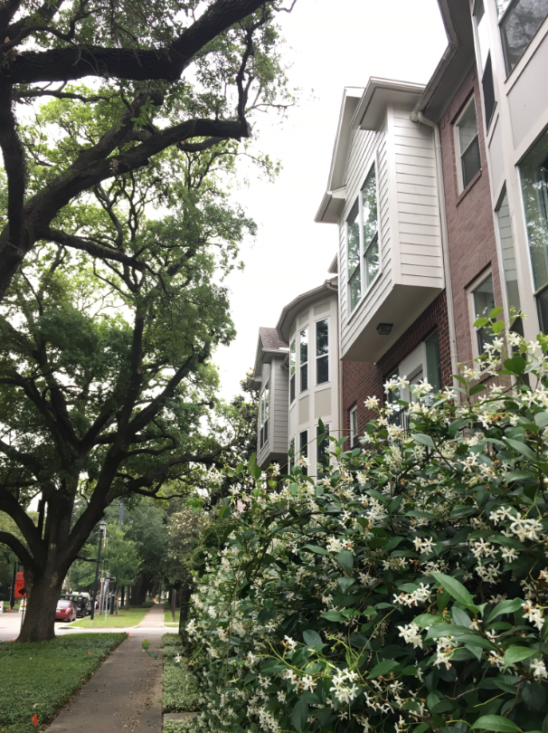
Major Tree Care
Hired The Bartlett Tree Expert Company
Improve the health of large trees
Reduce the risk of hazardous conditions
Total investment in project = $19,752
Project completed successfully, slightly over budget by $1,752

Slide 11
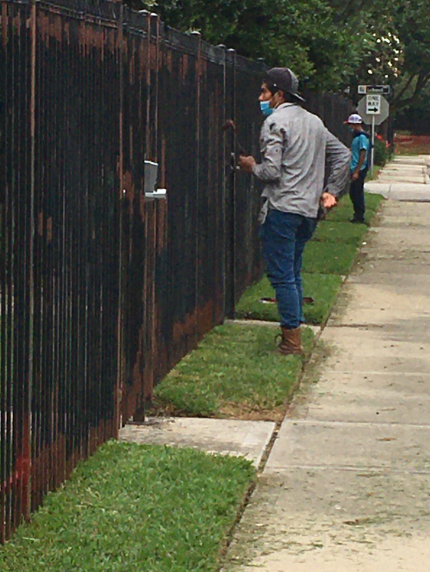
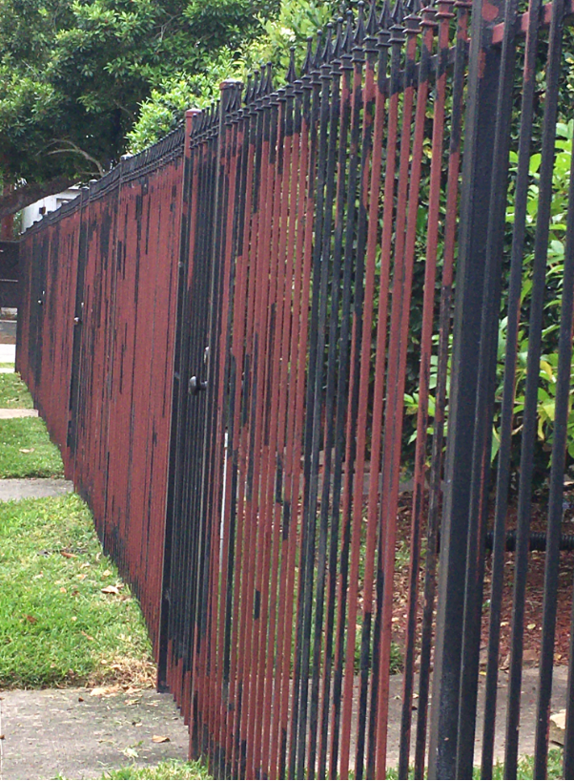
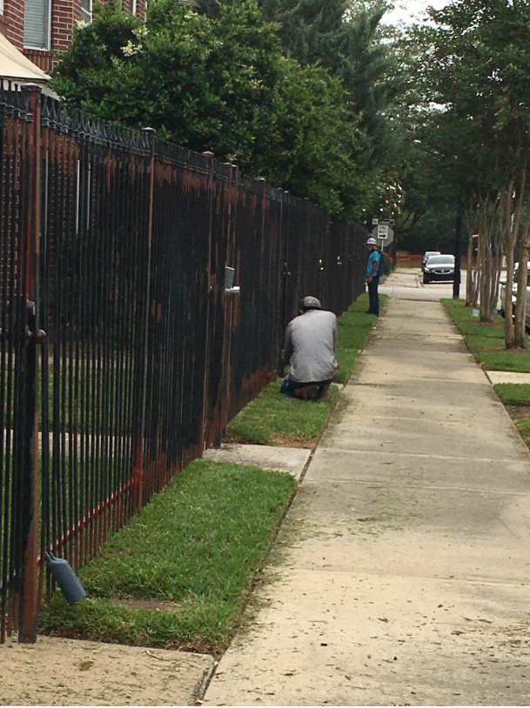
Additional Iron Fence Painting
Hired G&G Steelworks and Services
Total investment in project = $11,840
Project completed successfully under budget by $2,160

Slide 12
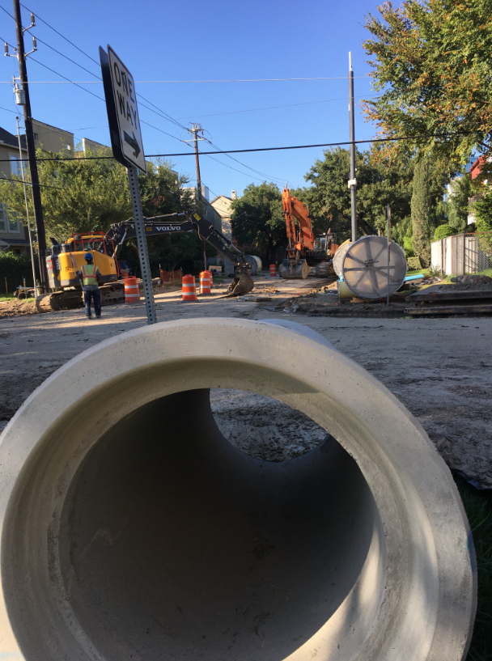
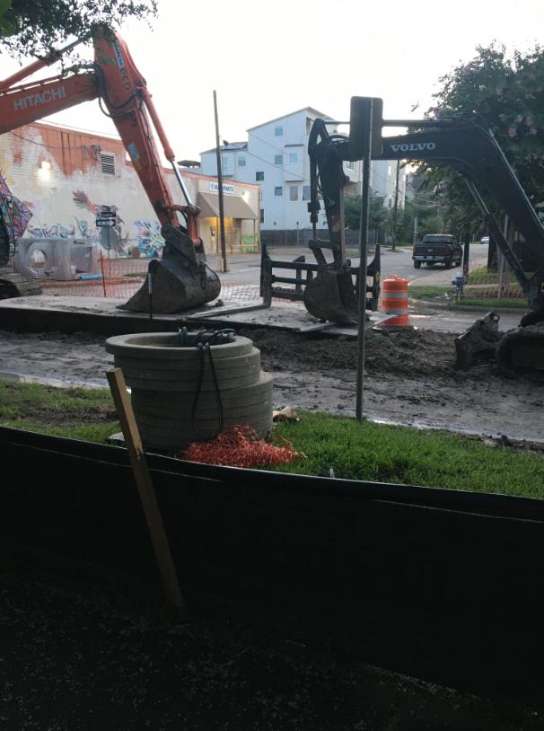
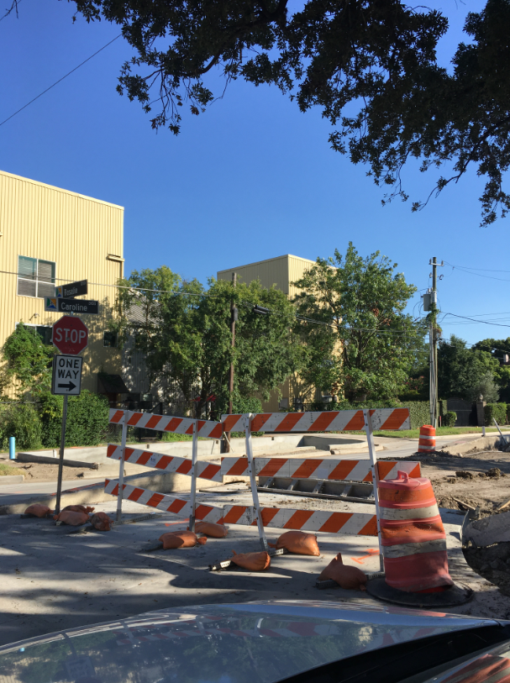
Street Construction / ROW Repair
Large waterline replacement
Major street construction and sidewalk / irrigation repairs required
No cost to BSHA

Slide 13
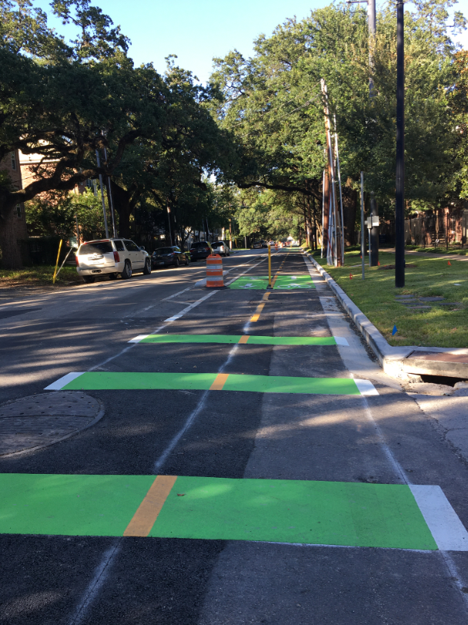
Austin St. Bike Lane
New 2-way bike lane installed
Connects to Gray St bike lane
Extends down to HCC at Alabama
No cost to BSHA

Slide 14
2020 - Accomplishments
Other
AT&T underground fiber analysis performed
Common infrastructure maintenance
Irrigation water leak management
Residential service water leak management
Fence repairs
Funded BSHA reserves by $6,000
Established reserves committee

Slide 15
2020 Financial Summary
Income received is on budget
No homeowners outstanding for 2020
165 of 165 collected (100% collected)
There are NO active legal collection actions against delinquent accounts
Expenses are projected to be within budget at year end
As of October 31, 2020 expenses are slightly over budget $135.83
Residential water: $7,479.15 over budget
Tree trimming: $2,555.51 over budget

Slide 16
Baldwin Square Homeowners Association
2020 Financial Overview
Budget Components | 2020 Actual | 2020 Budget
Landscaping Maintenance | $96,060 | $93,804
Water – Residential | $54,055 | $44,922
Trash & Recycling | $31,655 | $31,851
Administration | $31,489 | $32,123
Water – Irrigation | $18,338 | $17,932
Fence Paint & Repair | $12,910 | $14,000
Gate Repairs & Power | $9,722 | $14,530
Reserves | $6,000 | $6,000
Insurance | $3,586 | $3,854
Total | $263,815 | $259,016

Slide 17
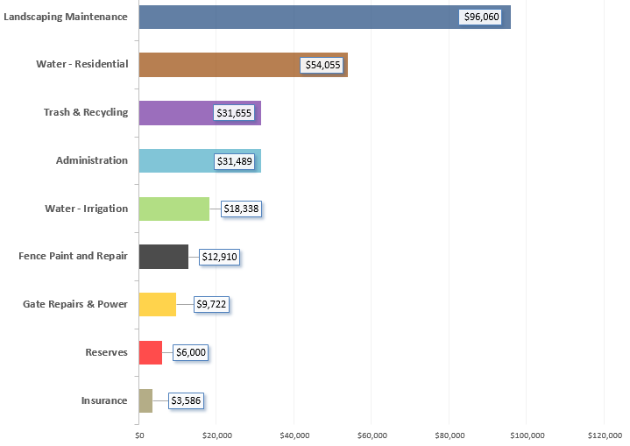
BSHA Year 2020 Expense Breakdown
Landscaping, Water & Trash was 77% of our total budget

Slide 18
BSHA Year 2021

Slide 19
2021 BSHA Board Goals
Landscaping
Improve ground cover / landscaping in bare ROW areas
Replace rusted switch back grate covers
Begin annual tree maintenance with Bartlett Trees
Continue iron fence painting / repair
Dennis Street Townhomes
Capital reserves (savings)
Additional $12,000 to be funded
Admin
Implement a new up-to-date Website for BSHA
Renew contract with Midtown Management Corporation

Slide 20
Baldwin Square Homeowners Association
2021 Budget Overview
Budget Components | 2021 Budget | 2020 Actual
Landscaping Maintenance | $92,042 | $96,060
Water – Residential | $56,759 | $54,055
Administration | $39,286 | $31,489
Trash & Recycling | $31,854 | $31,655
Water – Irrigation | $19,256 | $18,338
Reserves | $12,000 | $6,000
Gate Repairs and Power | $10,045 | $9,722
Fence Paint and Repair | $5,300 | $12,910
Insurance | $3,854 | $3,585
Total | $270,396 | $263,814

Slide 21
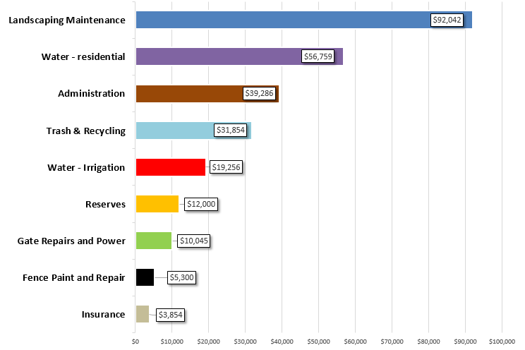
BSHA 2021 Budget Allocation
Water & Trash & Landscaping estimated at 77.4% of total budget

Slide 22
BSHA Assessment Methodology
Apply a very simple principal: “pay for what you have”
All equal / true common costs distributed equally by townhome
Community-specific costs distributed by amenity
Base costs common to all - split by 165 |  | (Property management, trash, insurance, legal, collections, etc.)
+ Gates & Electricity |  | (assessed for properties that have drive-in gate access)
+ Wood Fence |  | (assessed for communities who have wood fence perimeters)
+Metal Fence |  | (assessed for communities who have iron fence perimeters)
+ Landscaping |  | (assessed for all communities)
+ Irrigation maintenance |  | (assessed for all communities)
+ Residential Water |  | (assessed for properties that share a common meter)
+ Irrigation Water |  | (assessed for all properties)
= Total Assessment

Slide 23
BSHA 2021 Assessments
BSHA Community | # of Units | 2021 Assessment
Anita I | 3 | $1,680.51
Anita II | 3 | $1,540.77
Anita III | 7 | $1,400.75
Baldwin Court | 35 | $1,770.51
Baldwin Square I | 34 | $1,400.75
Baldwin Square II | 13 | $1,400.75
Baldwin Square III | 13 | $1,680.51
Baldwin Square IV | 16 | $1,770.51
Baldwin Square V | 13 | $1,760.23
Caroline Townhomes | 3 | $1,540.77
Crawford Court | 16 | $1,770.51
Dennis St Townhomes | 6 | $1,770.51
Tuam St Townhomes | 3 | $1,680.51

Slide 24
Questions & Answers www.baldwinsquare.org

